Slide 1
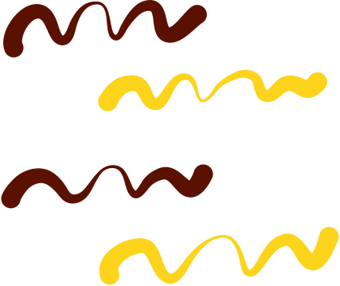


Project
Presentation
Hunter and Veda

Slide 2




Photolithography

Slide 3

Background
  Process used to transfer microscopic patterns onto a surface
  Most commonly in semiconductor fabrication to create integrated circuits.
  photolithography is the process that transfers shapes from a photo mask to the surface of a silicon wafer using light

Slide 4



Greek Word
PHOTO - LITHO - GRAPHY
printing with light

Slide 5
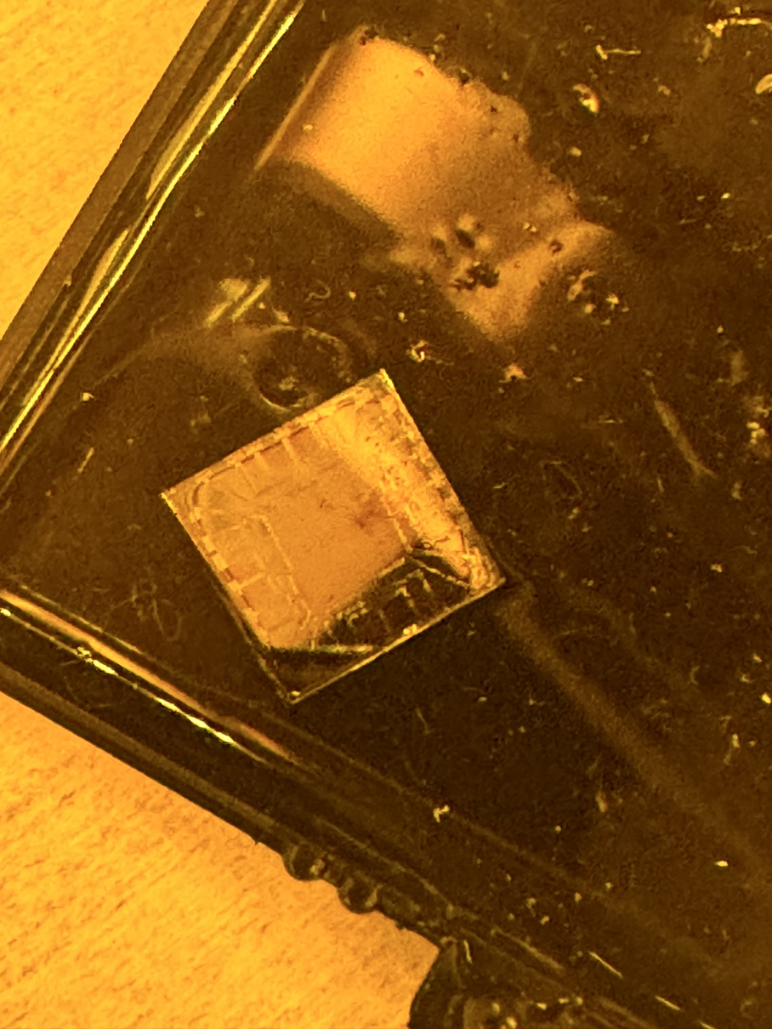
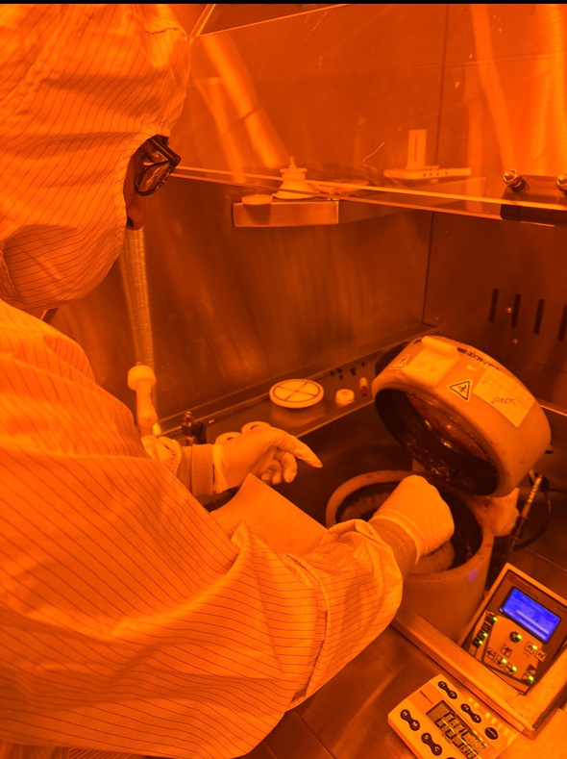
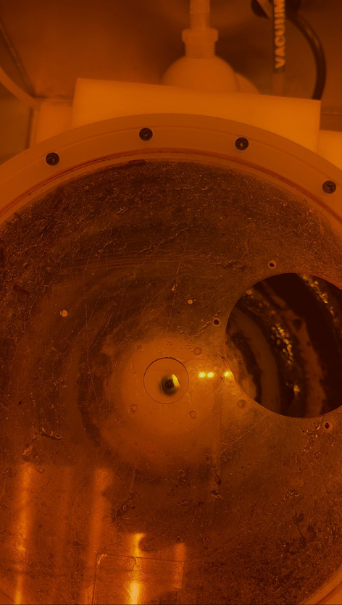

Spin Coding
  Put metals on spin coder chuck
  Drop LR1A solvent over chip
  Spin at 4000rpm
  Put on hot plate for 5 mins (180°)
  Repeat with chemical s1805
  Hot plate new heat 105°

Slide 6

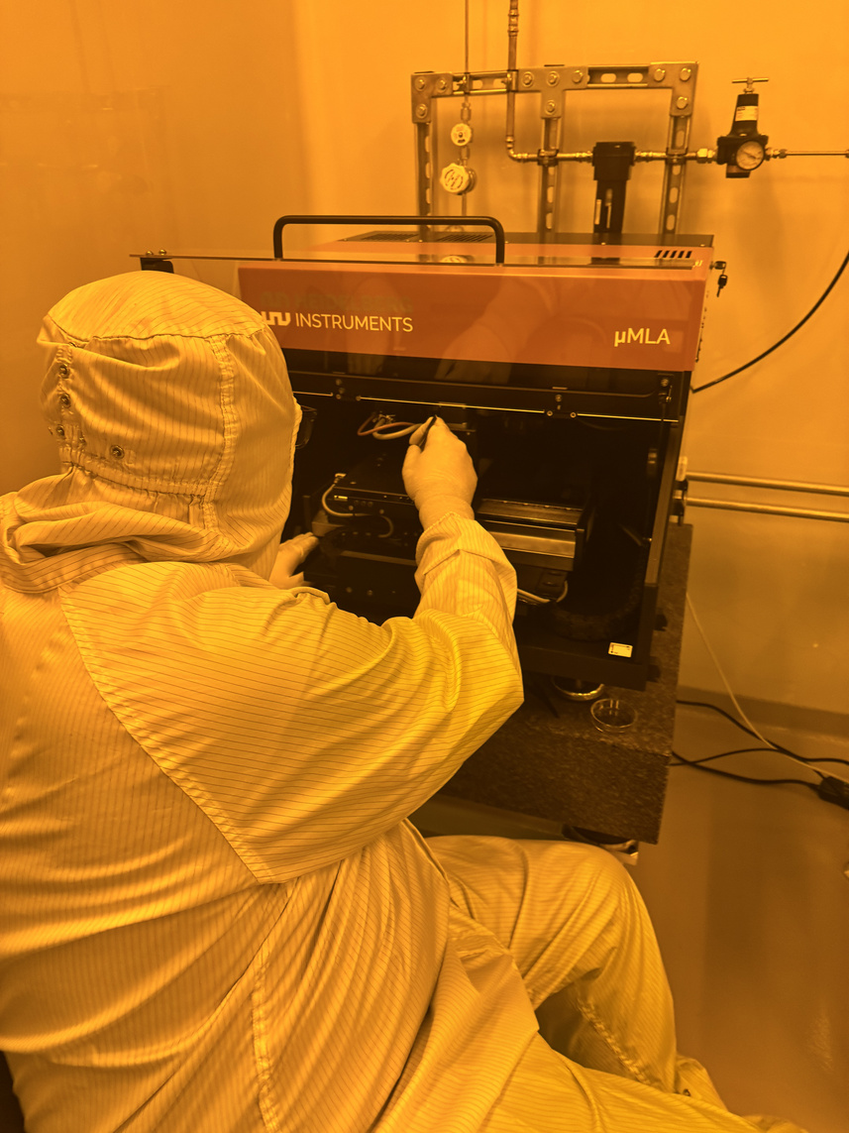
uMLA machine
• Moved chip into uMLA machine
• Used pneumatic focus to leave
graphene only where we wanted

Slide 7
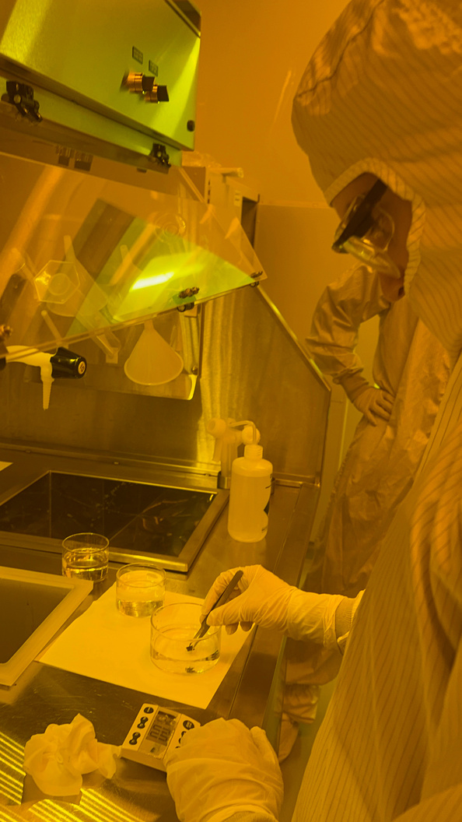
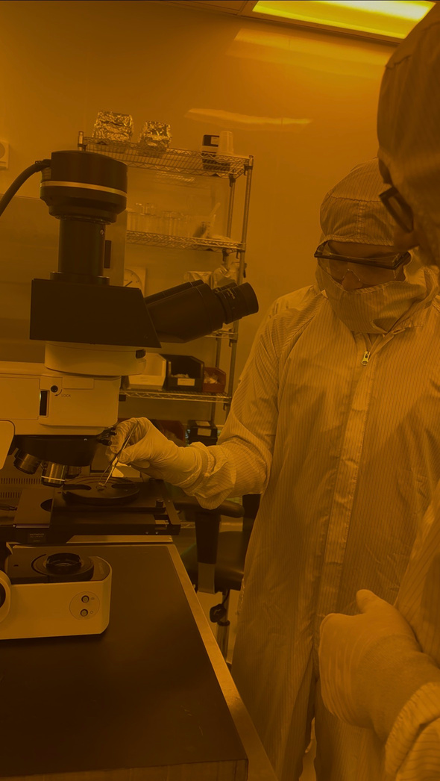

uMLA machine
  Move chip into TTMH (45 seconds)
  Then into water (30 sec)
  Then under microscope
  Can see unexposed graphene!

Slide 8
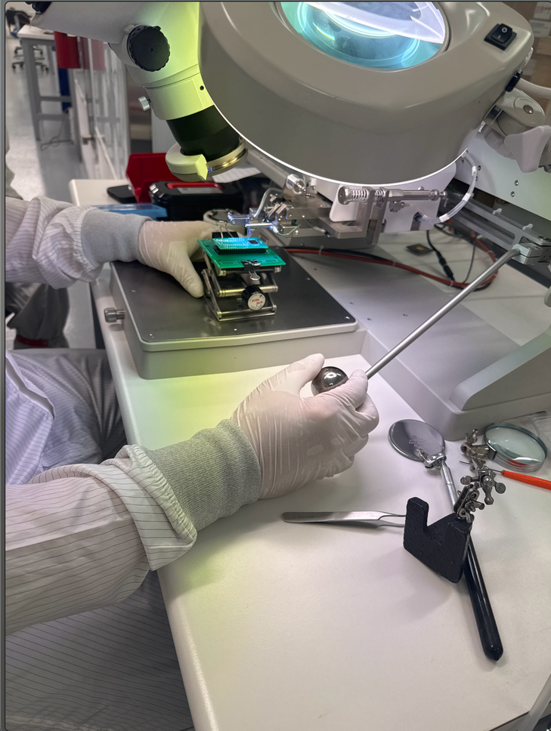
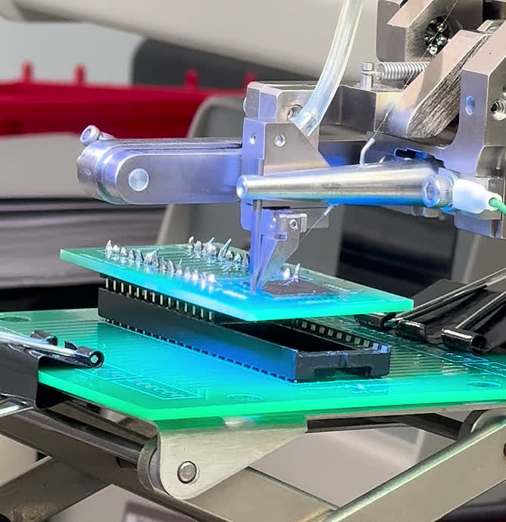
Wire Bonding
  Put chip securly on wire bonder
  Wire should be in between wedge and chip
  Bonding wire from SDD to chip

Slide 9
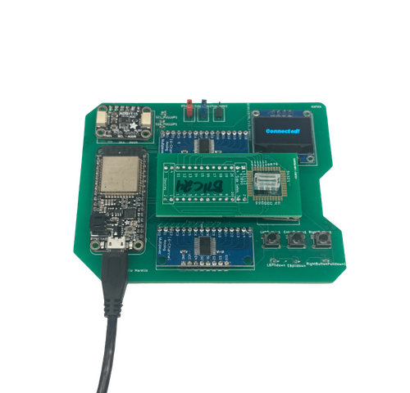
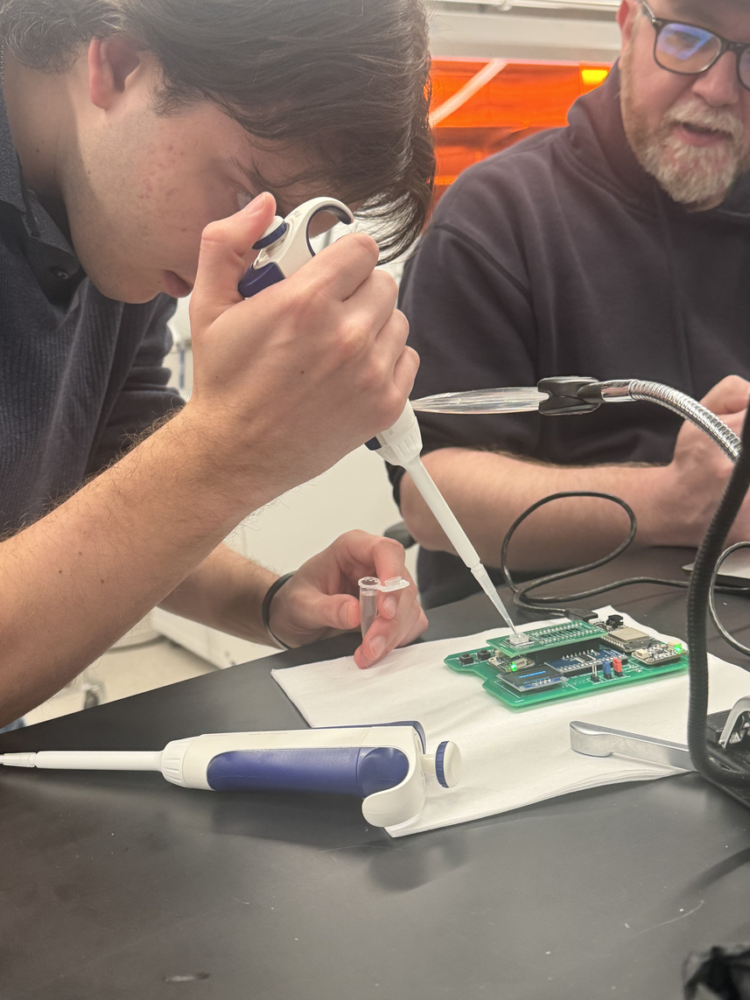
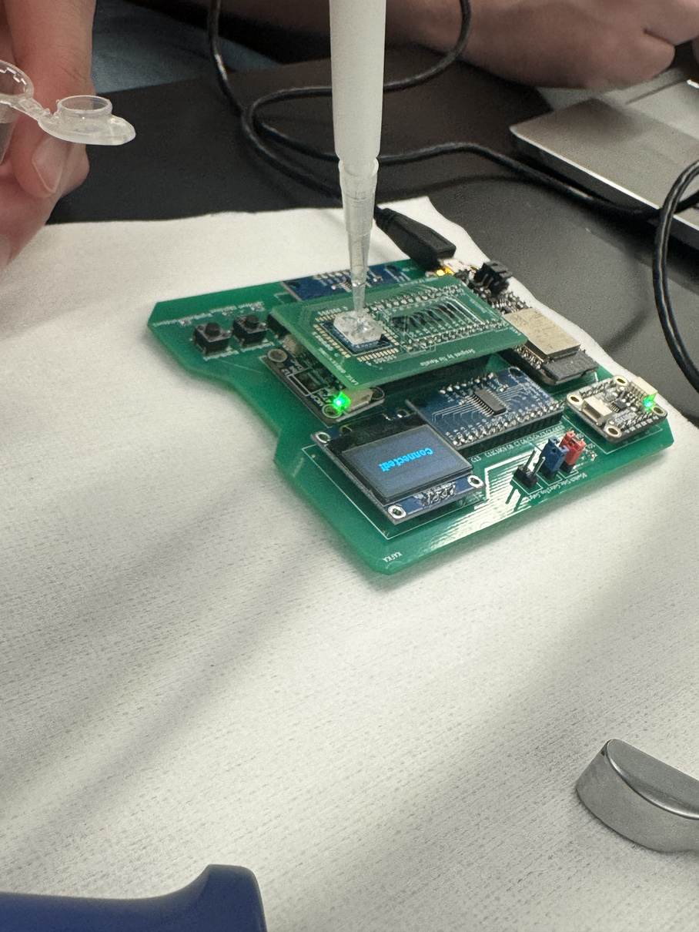
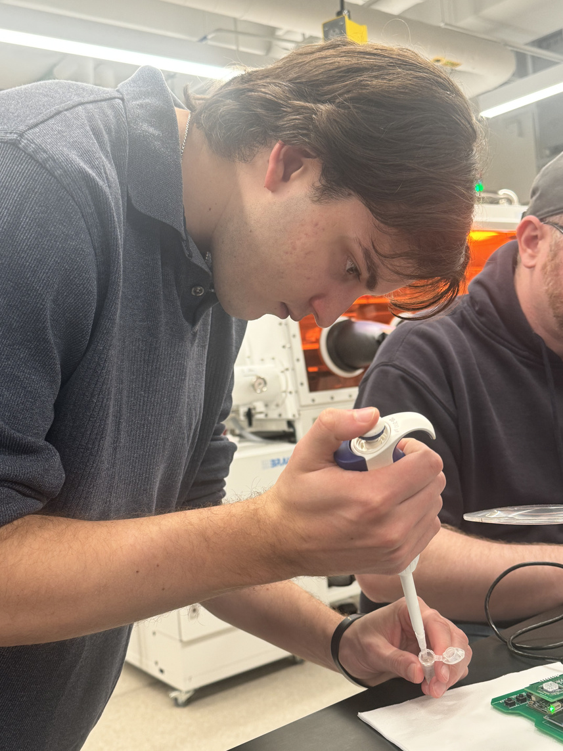

Dirac Measurement
  Pipette diluted PBS solution, pump a few times
  Put into chip (20 different graphite devices on chip)
  Measured Dirac points
  Set gate voltage max to 2000
  Set gate voltage delta to 100
Plot resistance vs gate voltage
Change gate voltage delta to 50, repeat

Slide 10
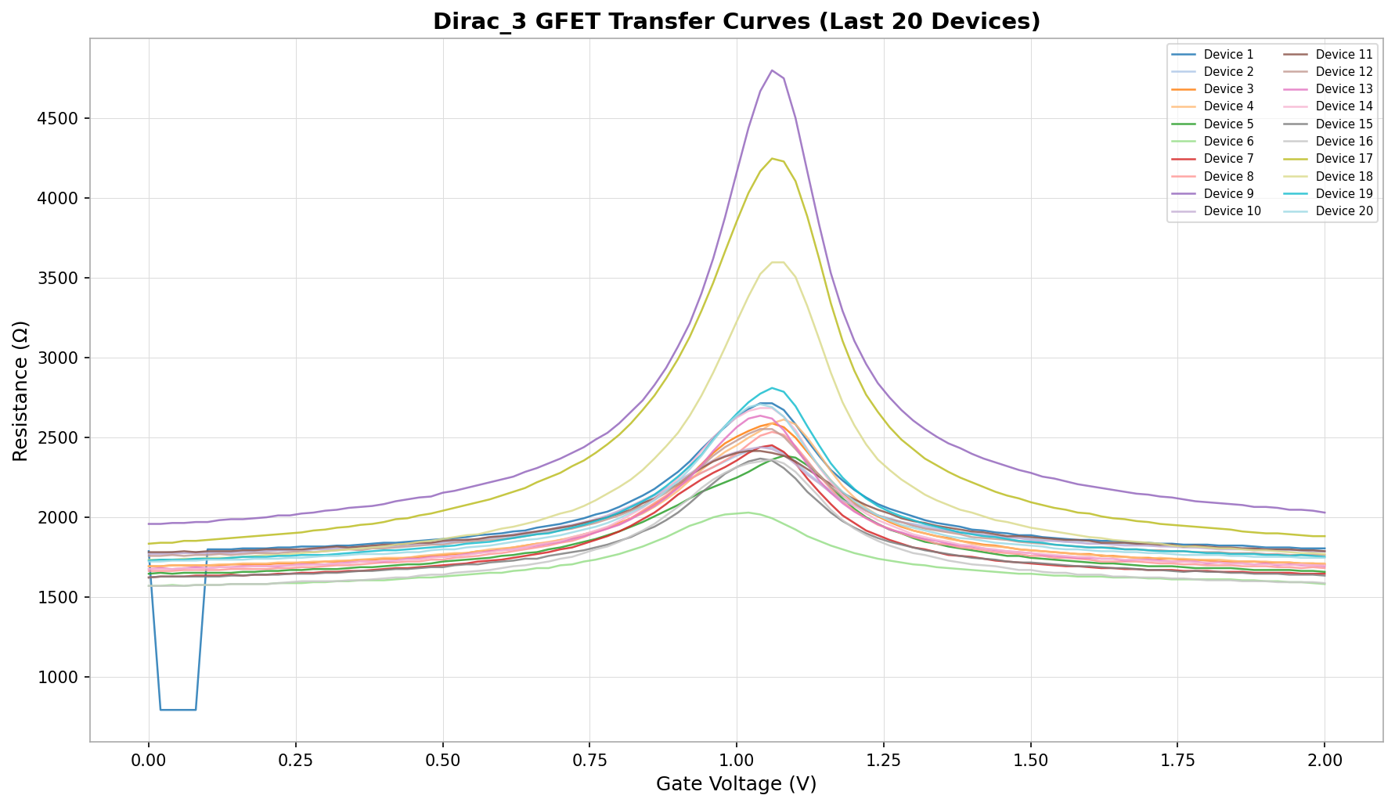
The graph shows resistance vs gate voltage for all 20 graphene devices.
As you increase the gate voltage from 0V, resistance rises, you're pushing the graphene toward charge neutrality. It hits a peak at ~1.05V that's the Dirac point, where conductivity is lowest because there are no free carriers to move charge. Then after the peak, resistance drops again as we now start adding electrons instead of removing holes.

Slide 11
9
17
So this shape is the signature of graphene's behavior. It conducts on both sides of the peak, just with different carriers (holes on the left, electrons on the right).
The tight clustering of all the peaks at the same voltage is the other key thing , it means all 20 devices behaved nearly identically, which validates that our fabrication process was clean and uniform.

Slide 12
Transconductance
(essentially the gain)
  gm = ΔI / ΔVg
  Measures how effectively gate voltage controls current
  Extracted from slope of transfer curve on either side of Dirac point
  Device 9: gm ≈ 0.26 mS/V
  Symmetric on electron and hole branches

Slide 13

Thank you
Hunter and Veda

