Slide 1


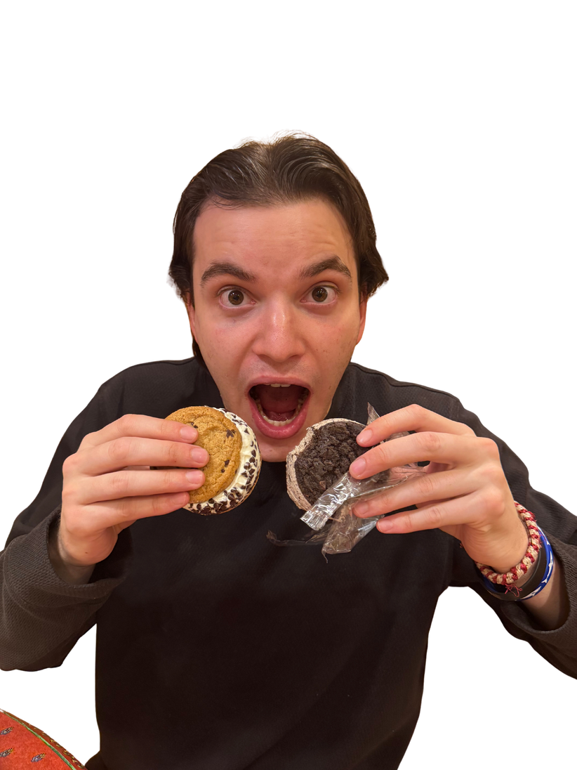


GRAPHENE
TRANSFERS
Veda and Hunter

Slide 2
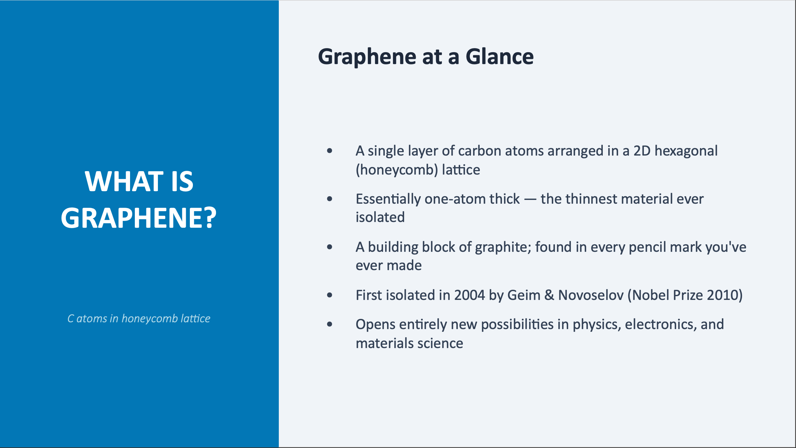

Slide 3
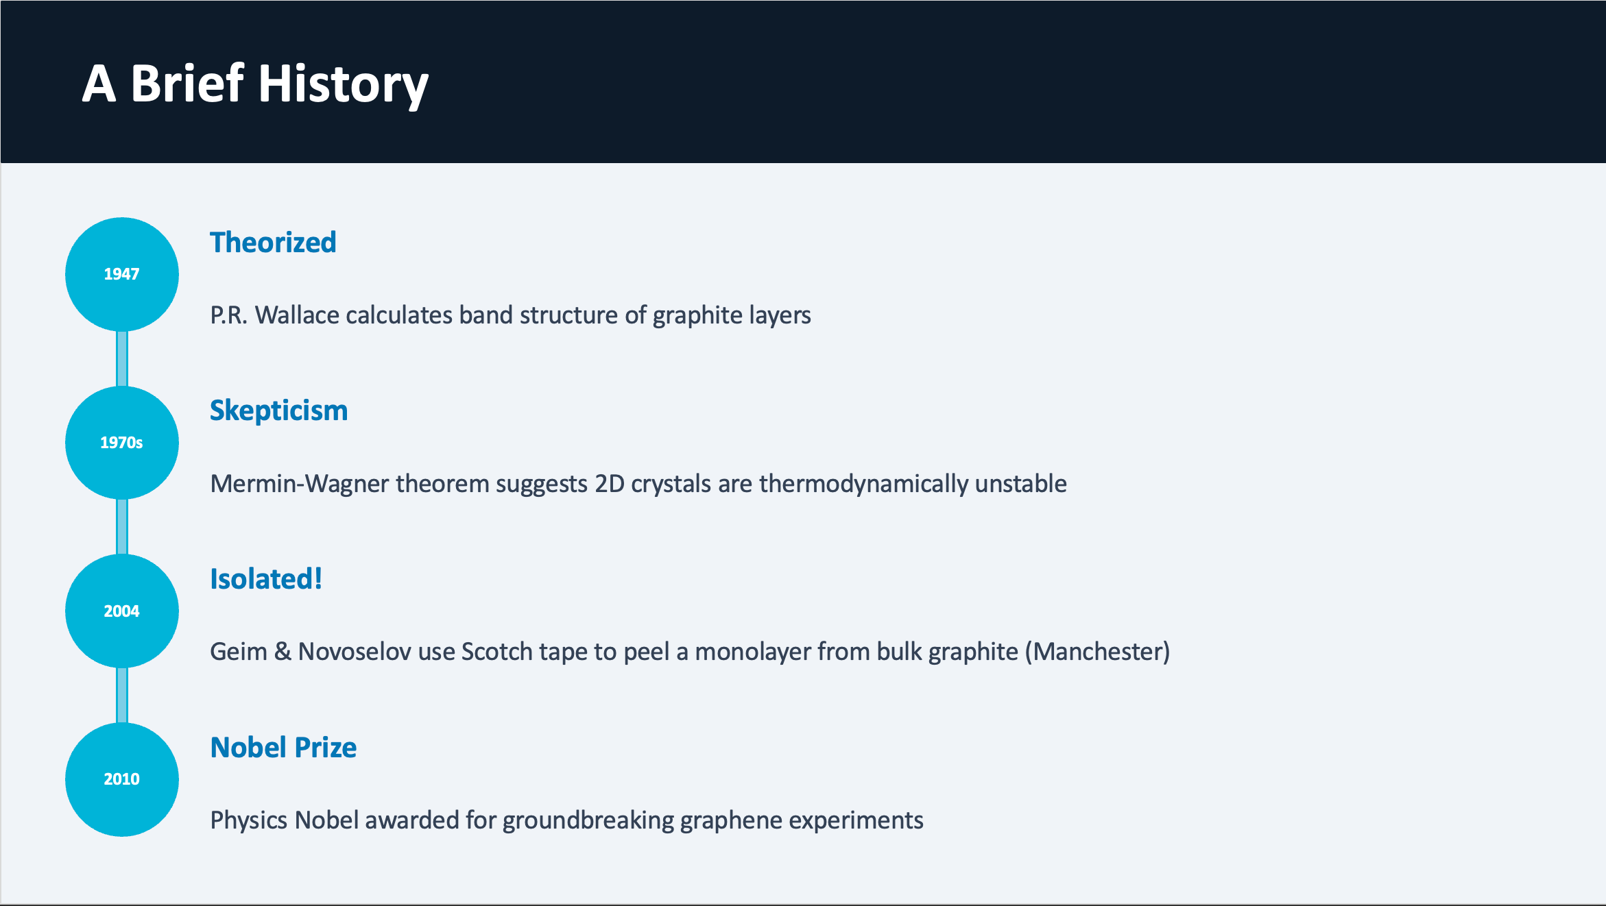


Slide 4
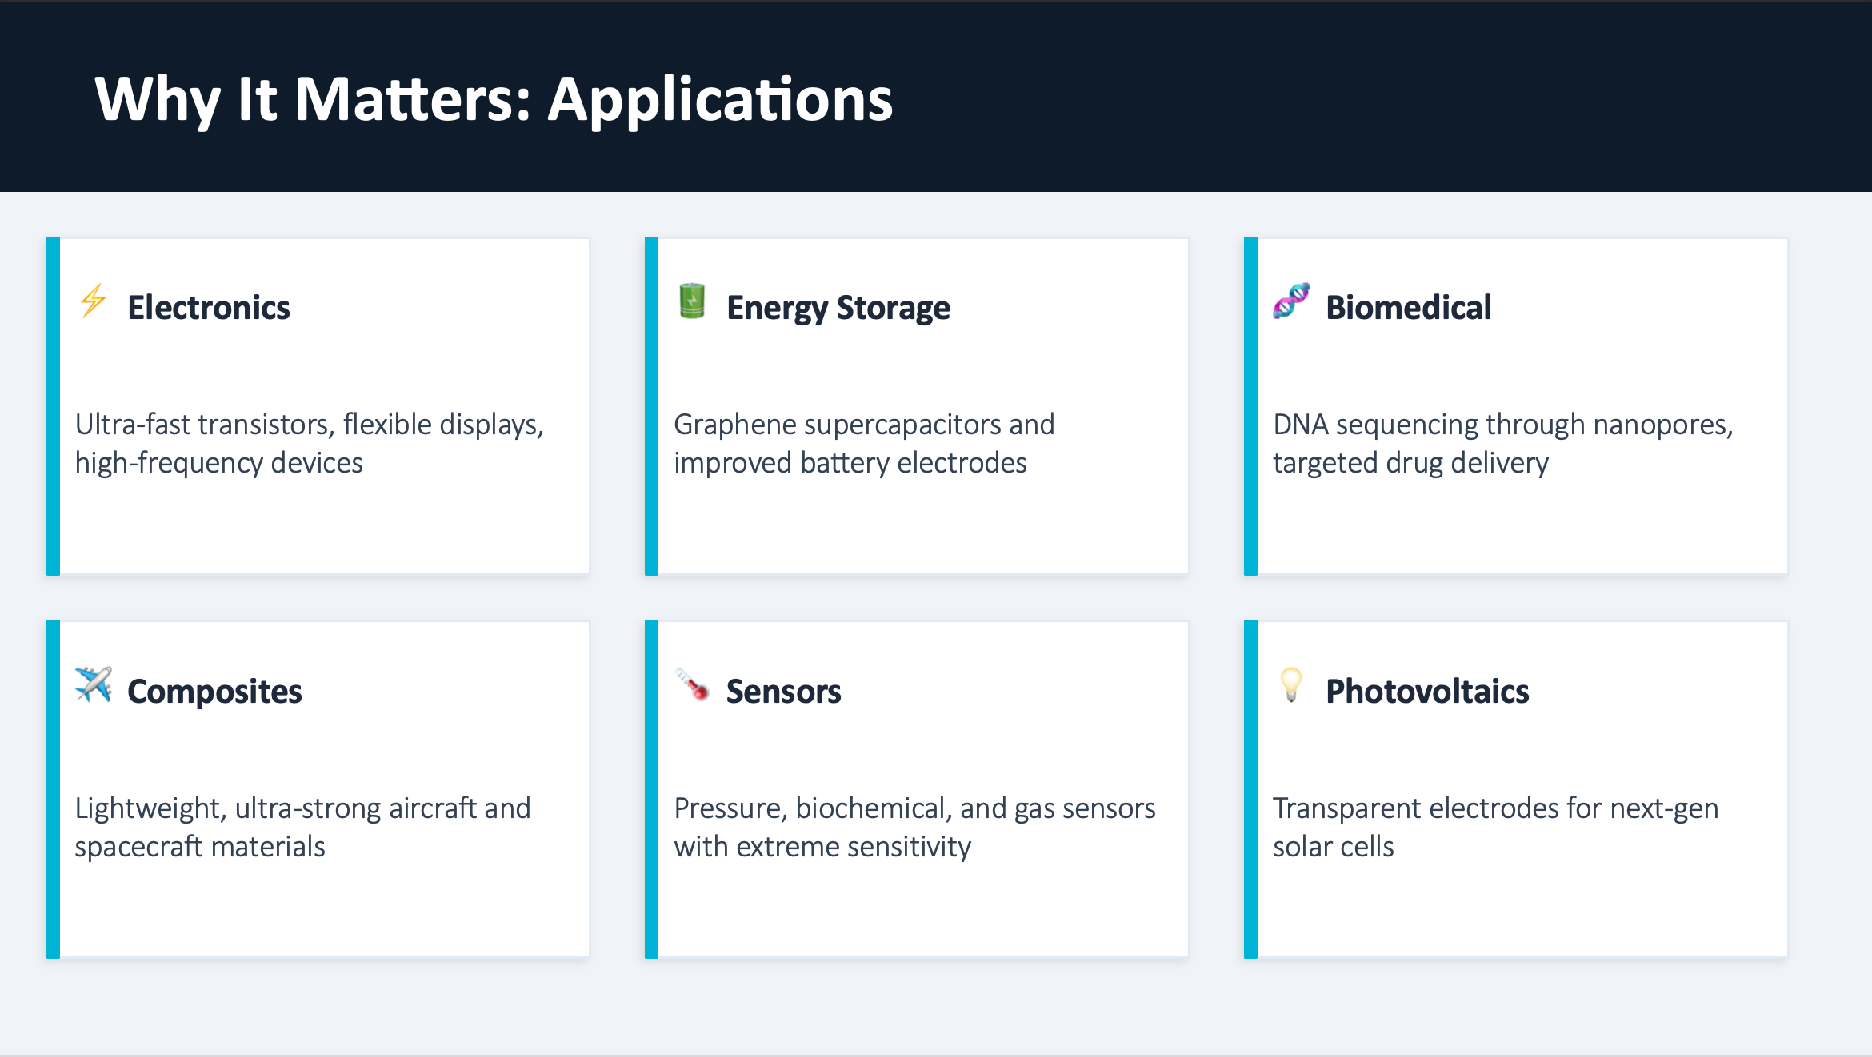

Slide 5
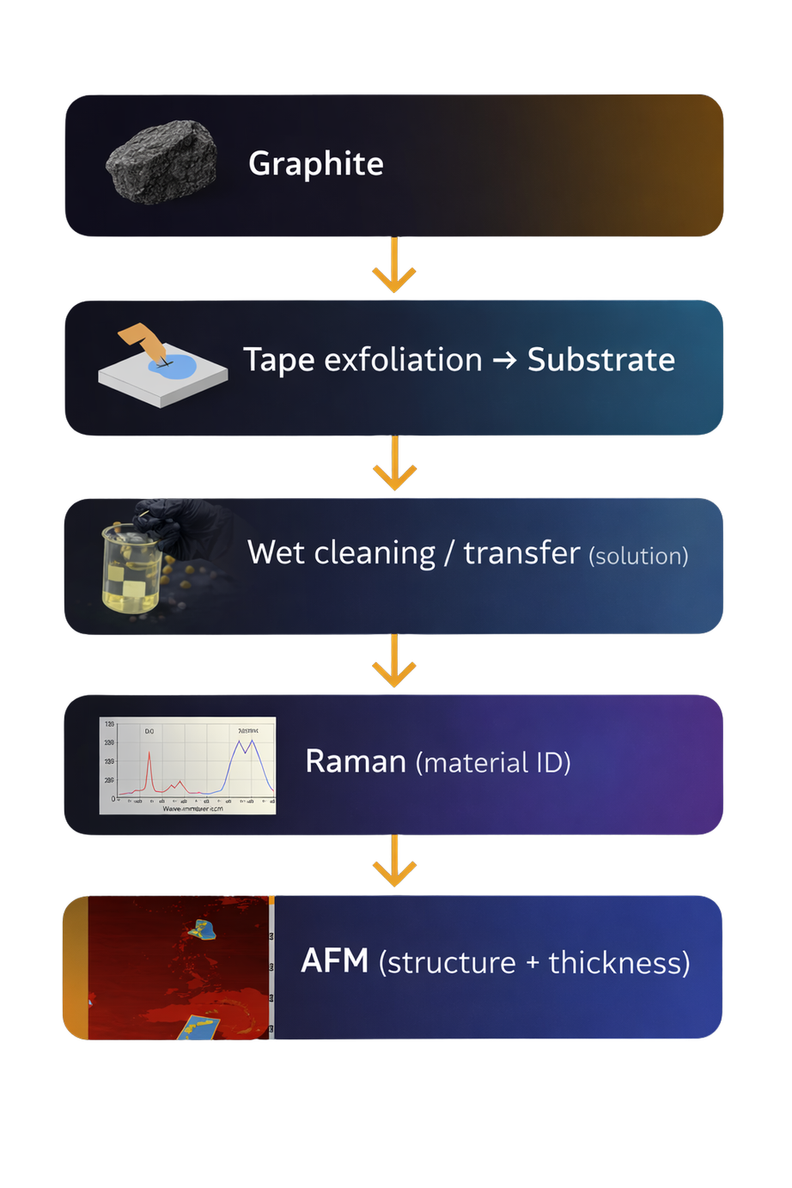

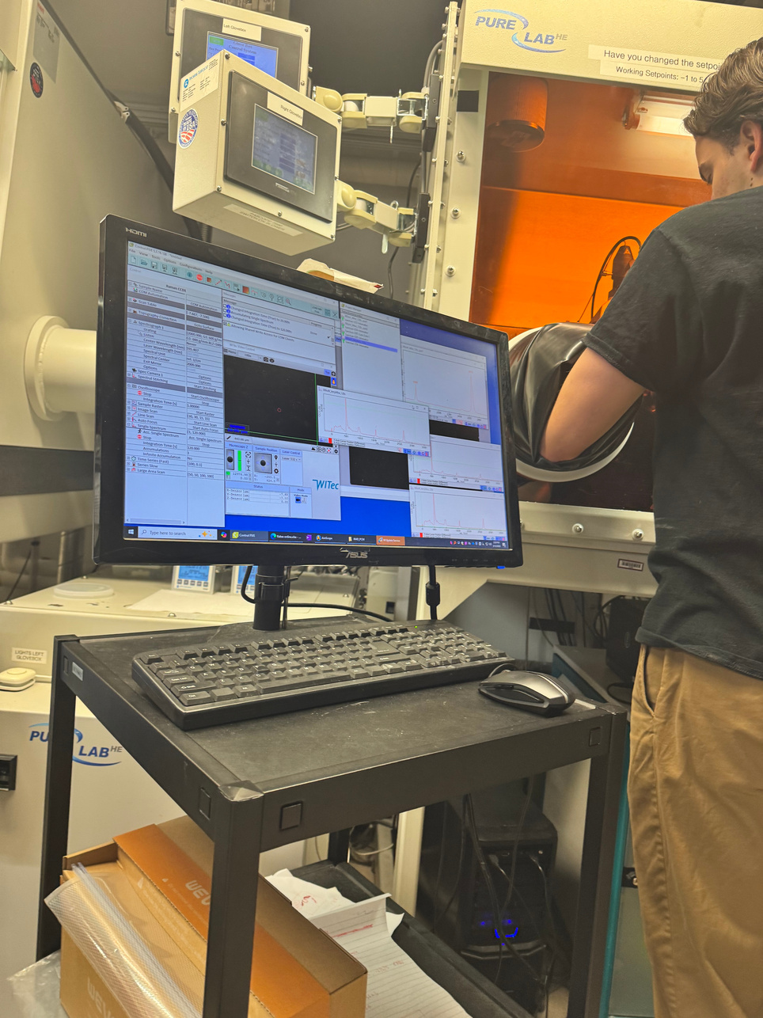
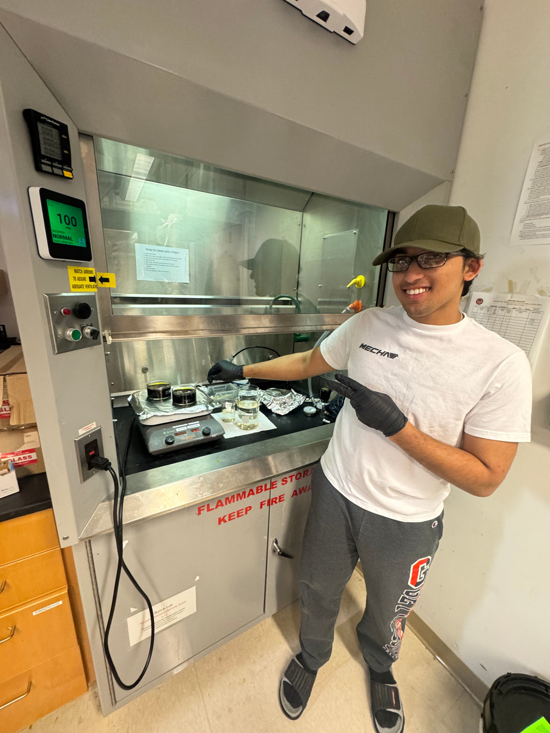
EXPERIMENTAL
STRUCTURE

Slide 6
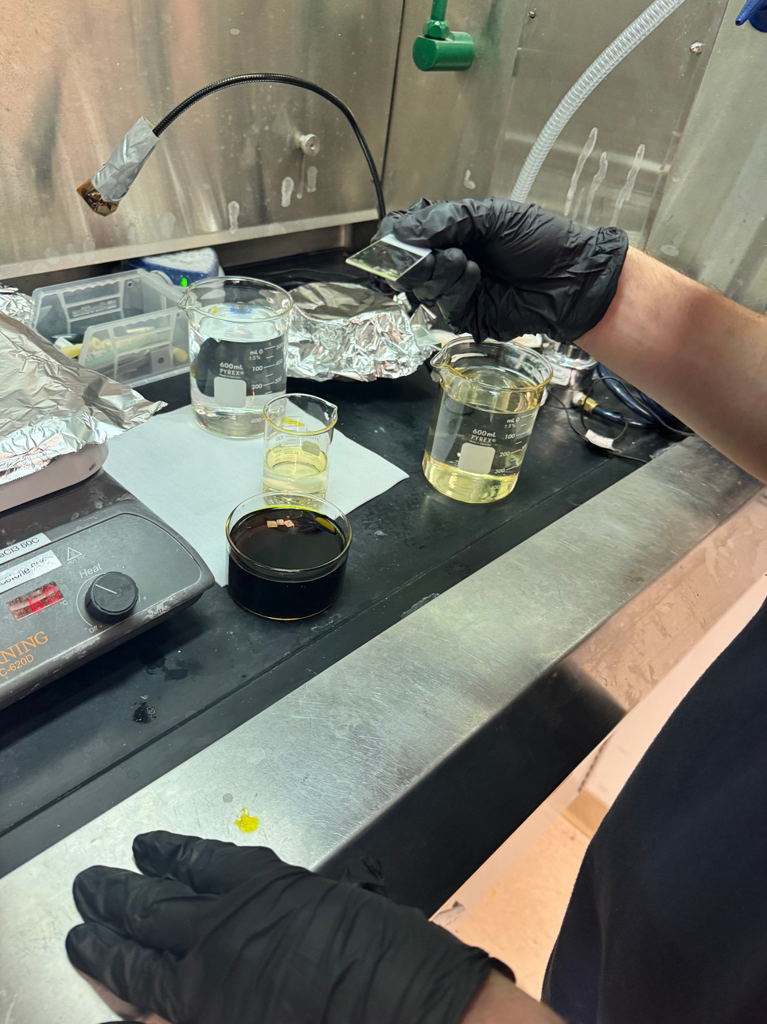

  CVD PATHWAY, GRAPHENE WAS GROWN ON COPPER AND TRANSFERRED USING A WET TRANSFER PROCESS.
  A PMMA support layer was used, the copper was etched away, and the graphene film was transferred onto a new substrate.
  The goal here was to preserve a continuous graphene film during transfer.

Slide 7
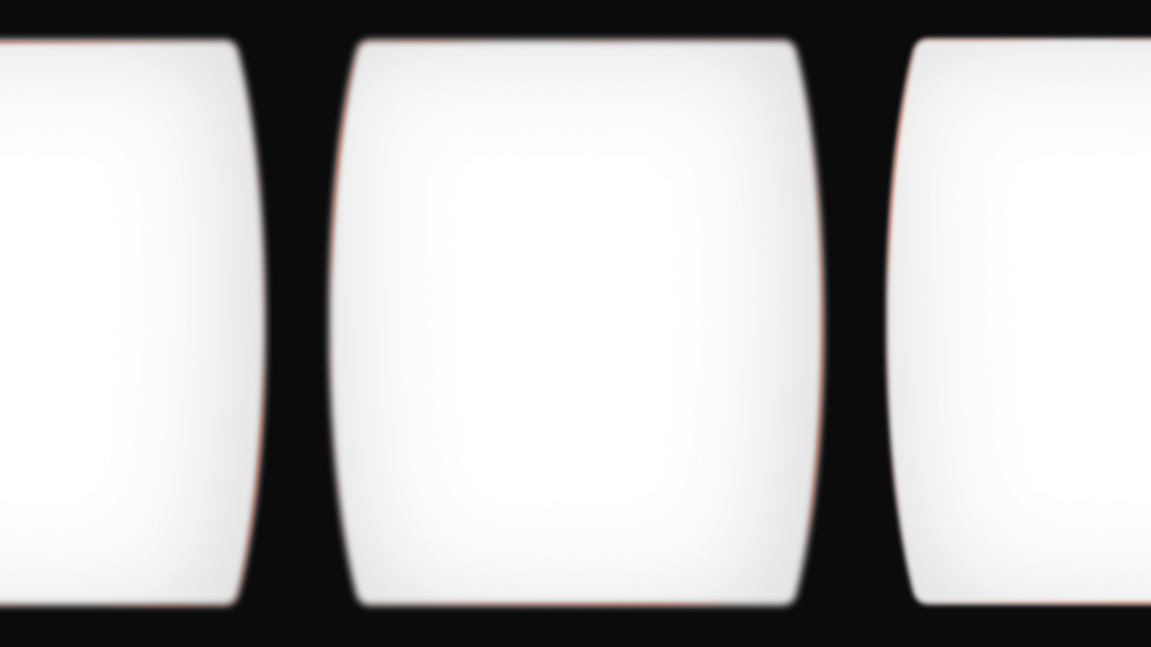
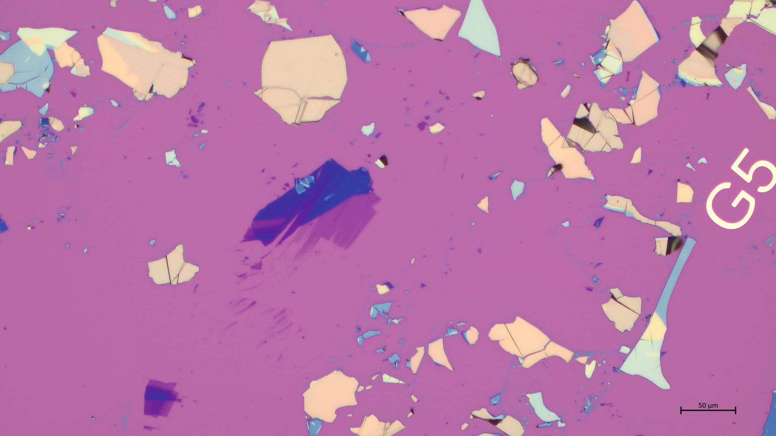
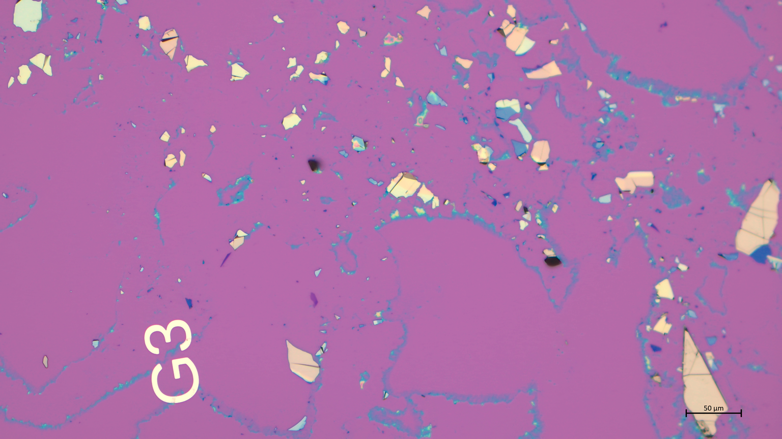
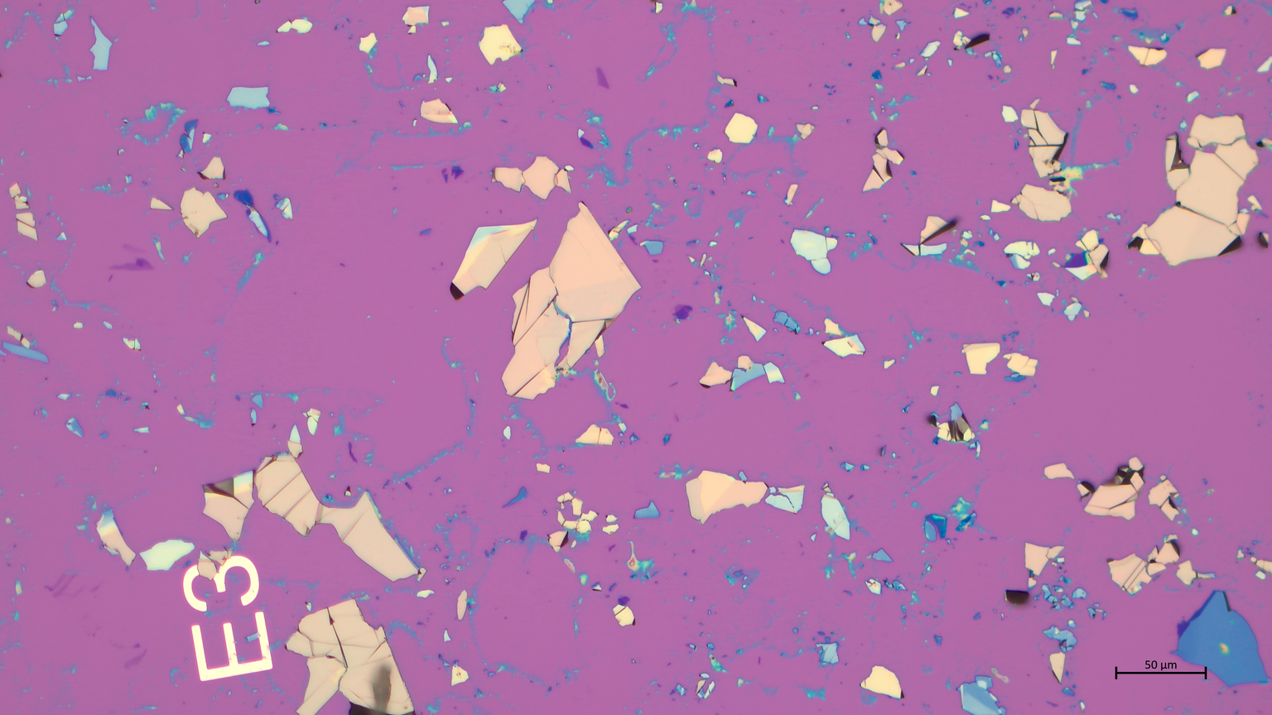
In contrast, exfoliation produces isolated graphene flakes.
These images show flakes we observed under optical microscopy.
You can see significant variation in size, shape, and thickness contrast across the sample.
This variability is expected and is why characterization becomes critical.

Slide 8
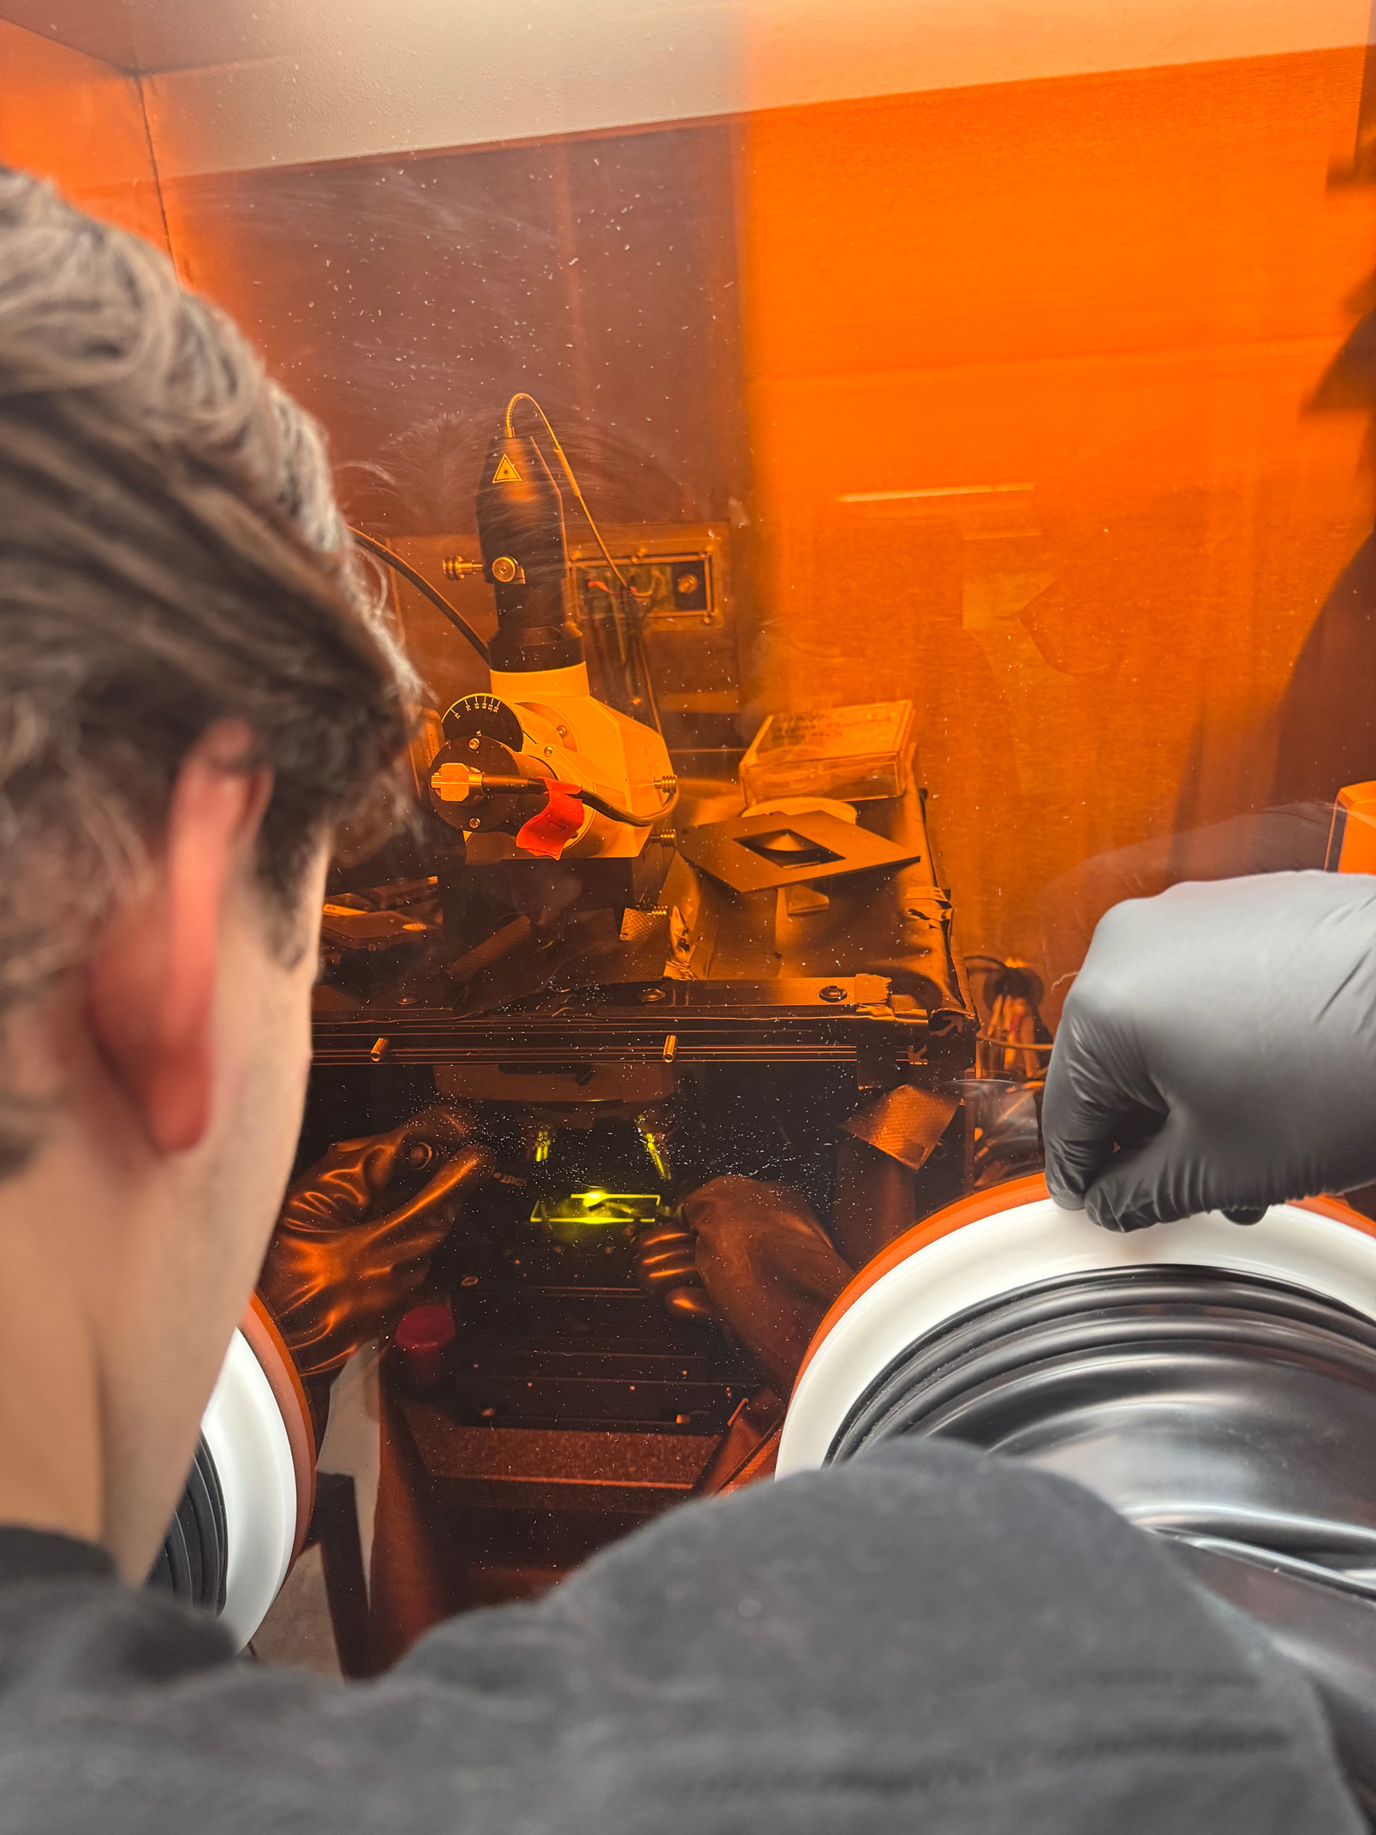
WE USED TWO COMPLEMENTARY CHARACTERIZATION METHODS.
  RAMAN spectroscopy was used for the transferred CVD graphene to identify graphene signatures and assess structural quality.
  AFM WAS USed for exfoliated flakes to directly measure surface topography and step height.

Slide 9
CHARACTERIZATION

Slide 10
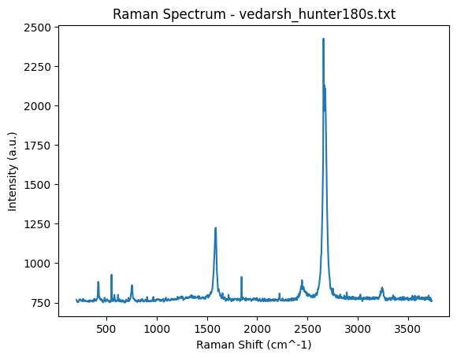
  Here we show Raman spectroscopy data from the transferred graphene sample.
  After removing measurement artifacts, we observe key graphene features.

Slide 11
  In particular, we see a G peak around ~1580 cm⁻¹ and a strong 2D peak near ~2700 cm⁻¹.
  The presence of these peaks confirms that the transferred film retains graphene-like structure after processing.

Slide 12
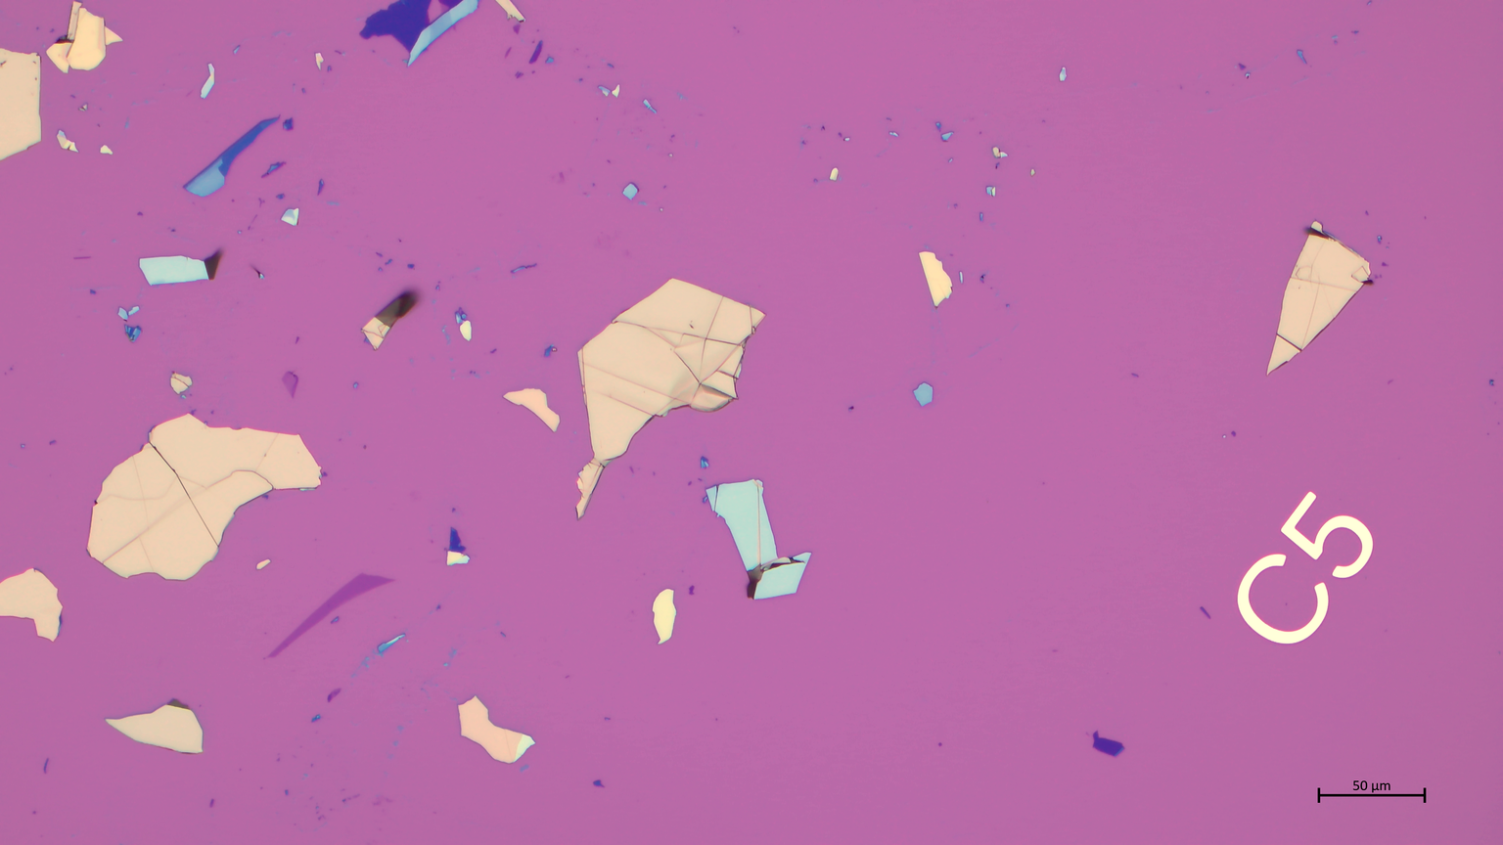
After Raman analysis, we examined the samples under optical microscopy to identify graphene flakes.
Again, these images show that the flakes vary significantly in size, shape, and contrast across the substrate.
This helped us select regions of interest for further characterization.

Slide 13
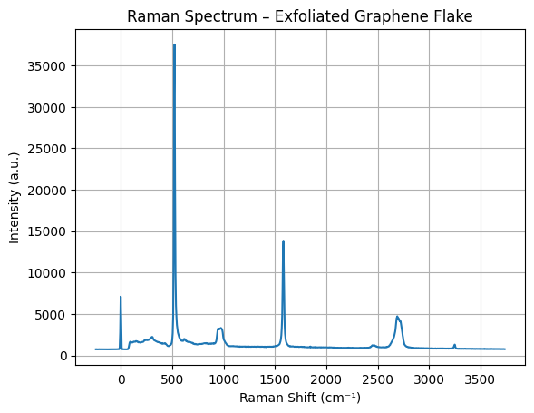

Slide 14
  Here we show Raman data from exfoliated graphene flakes.
  We observe a strong peak around ~1580 cm⁻¹ corresponding to the G band, along with a D peak near ~1350 cm⁻¹ and a 2D peak near ~2700 cm⁻¹.

Slide 15
  These features confirm the presence of graphene, while the D peak indicates some level of defects introduced during exfoliation.

Slide 16
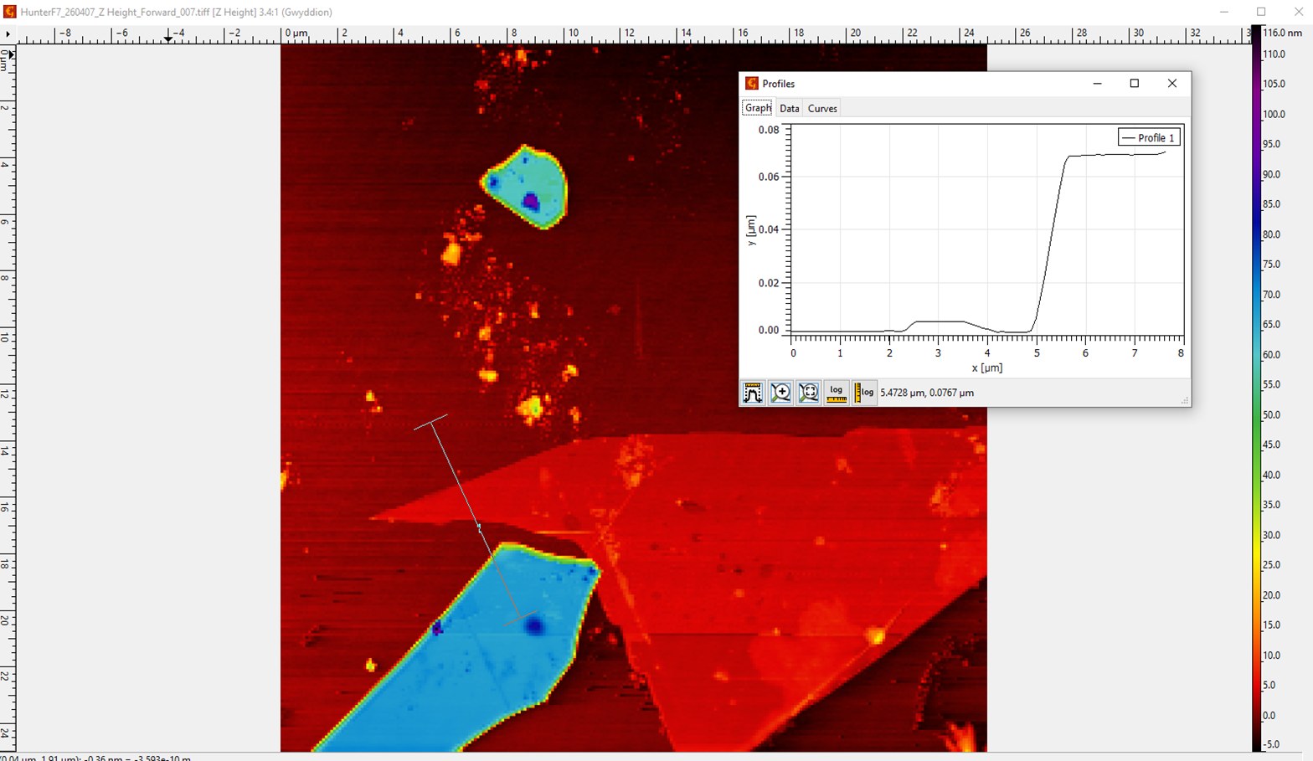
  Here we show AFM measurements of exfoliated graphene flakes.
  The AFM image reveals clear contrast between the substrate and the flake region, while the height profile shows a sharp step edge.

Slide 17
  This confirms the presence of a distinct layered structure, rather than gradual surface roughness.
  The measured step height suggests that the flakes are not uniform, and may consist of multiple graphene layers.

Slide 18
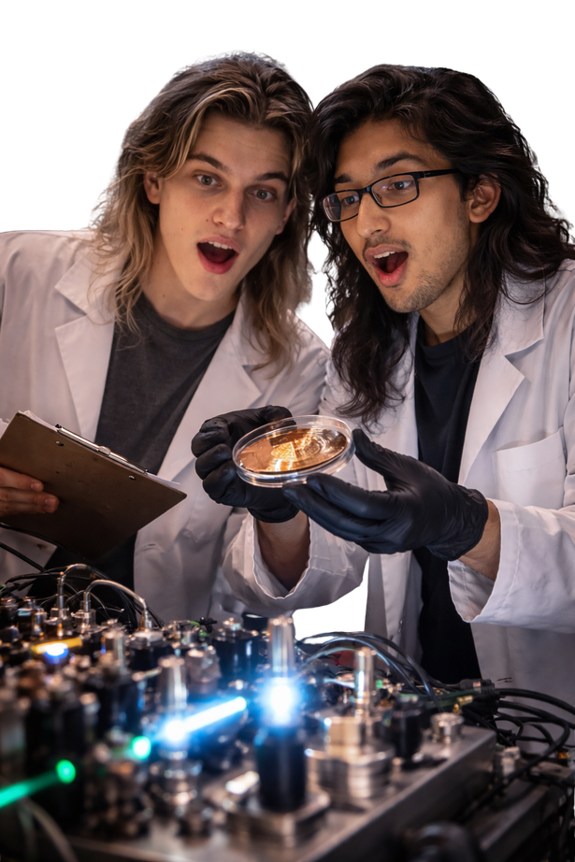

Together, Raman and AFM provide complementary information,
allowing us to both identify graphene and understand its physical structure.

